Slide 1
PowerShell with Azure
Dara Oladapo
@DaraOladapo

Slide 2
Agenda
Day | Goals
1 | Introduction to Azure PowerShell
2 | Manage Azure Resources with Azure PowerShell
3 | Manage Azure Resources with Azure PowerShell
4 | Advanced Azure Management with PowerShell
5 | Exam Tips, Q&A
Notes:
https://docs.microsoft.com/en-us/powershell/azure/?view=azps-3.8.0

Slide 3
Day 1 Introduction to Azure PowerShell
Goals
Overview of Azure PowerShell
Installing Azure PowerShell Install PowerShell Install Azure PowerShell
Familiarizing with Basic PowerShell Commandlets

Slide 4
Overview of Azure PowerShell
Azure PowerShell is a set of cmdlets for managing Azure resources directly from the PowerShell command line. Azure PowerShell is designed to make it easy to learn and get started with, but provides powerful features for automation. Written in .NET Standard, Azure PowerShell works with PowerShell 5.1 on Windows, and PowerShell 6.x and higher on all platforms.

Slide 5
Installing Azure PowerShell
Install PowerShell
https://bit.ly/getpsh7
Install Azure PowerShell
For Current User
Install-Module -Name Az -AllowClobber -Scope CurrentUser
For All Users
Install-Module -Name Az -AllowClobber -Scope AllUsers
Notes:
Over the years, there have been many releases of PowerShell. Initially, Windows PowerShell was built on the .NET Framework and only worked on Windows systems. With the current release, PowerShell uses .NET Core 3.1 as its runtime. PowerShell runs on Windows, macOS, and Linux platforms.
PowerShell Core is an Open Source project on GitHub. See the following articles for more information on installing PowerShell on various supported and experimental platforms.

Slide 6
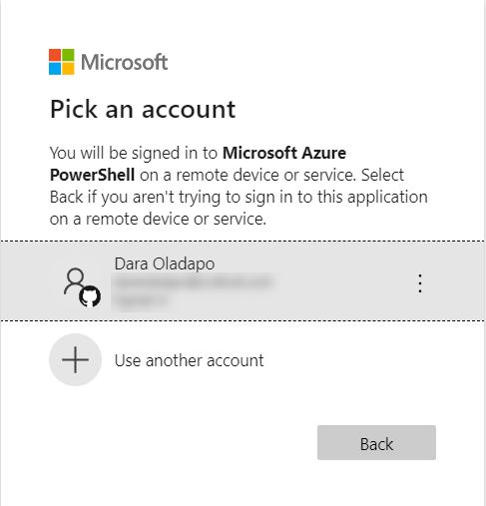
Installing Azure PowerShell
Always Remember before starting any Azure Connection Session
Run Connect-AzAccount and follow the instructions on the screen
If you have more than one subscription
az account set --subscription $SubscriptionId
Notes:
Over the years, there have been many releases of PowerShell. Initially, Windows PowerShell was built on the .NET Framework and only worked on Windows systems. With the current release, PowerShell uses .NET Core 3.1 as its runtime. PowerShell runs on Windows, macOS, and Linux platforms.
PowerShell Core is an Open Source project on GitHub. See the following articles for more information on installing PowerShell on various supported and experimental platforms.

Slide 7
Familiarizing with Basic PowerShell Commandlets
Noun or Verb | Abbreviation
Get | g
Set | s
Item | i
Location | l
Command | cm
Alias | al
Cmdlet name | Alias
Get-Item | gi
Set-Item | si
Get-Location | gl
Set-Location | sl
Get-Command | gcm
Get-Alias | gal
Notes:
Aliases

Slide 8
Familiarizing with Basic PowerShell Commandlets
Set-Alias -Name gi -Value Get-Item
Set-Alias -Name si -Value Set-Item
Set-Alias -Name gl -Value Get-Location
Set-Alias -Name sl -Value Set-Location
Set-Alias -Name gcm -Value Get-Command
Notes:
Creating Aliases

Slide 9
Day 2 Manage Azure Resources with Azure PowerShell
Goals
Manage Virtual Machines Create Virtual Machines Manage Storage Monitor Virtual Machines
Manage Web Applications Create App Configure App Scale App Connect app to Resources Backup and Restore App Monitor App

Slide 10
Day 3 Manage Azure Resources with Azure PowerShell
Goals
Manage Azure SQL Database Create and configure single databases, and elastic pools Configure geo-replication and failover Configure a failover group Scale a single database and an elastic pool Auditing and threat detection Restore, copy, and import a database Sync data between databases

Slide 11
Day 4 Advanced Azure Management with PowerShell
Goals
Azure Desired State Configuration with PowerShell

Slide 12
Day 5 Exam Tips, Q&A
Goals
Q & A
Additional Resource Links
Exam Tips

